Slide 1

Front End Engineering ll - Project
Team Details:
Name Rollno.
Mugdha 2210990585
Nitika Bansal 2210990623
Payal Dhiman 2210990647
Subject Teacher - Mr. Vikas Patel
Chitkara University Institute of Engineering and Technology,
Chitkara University, Punjab

Slide 2

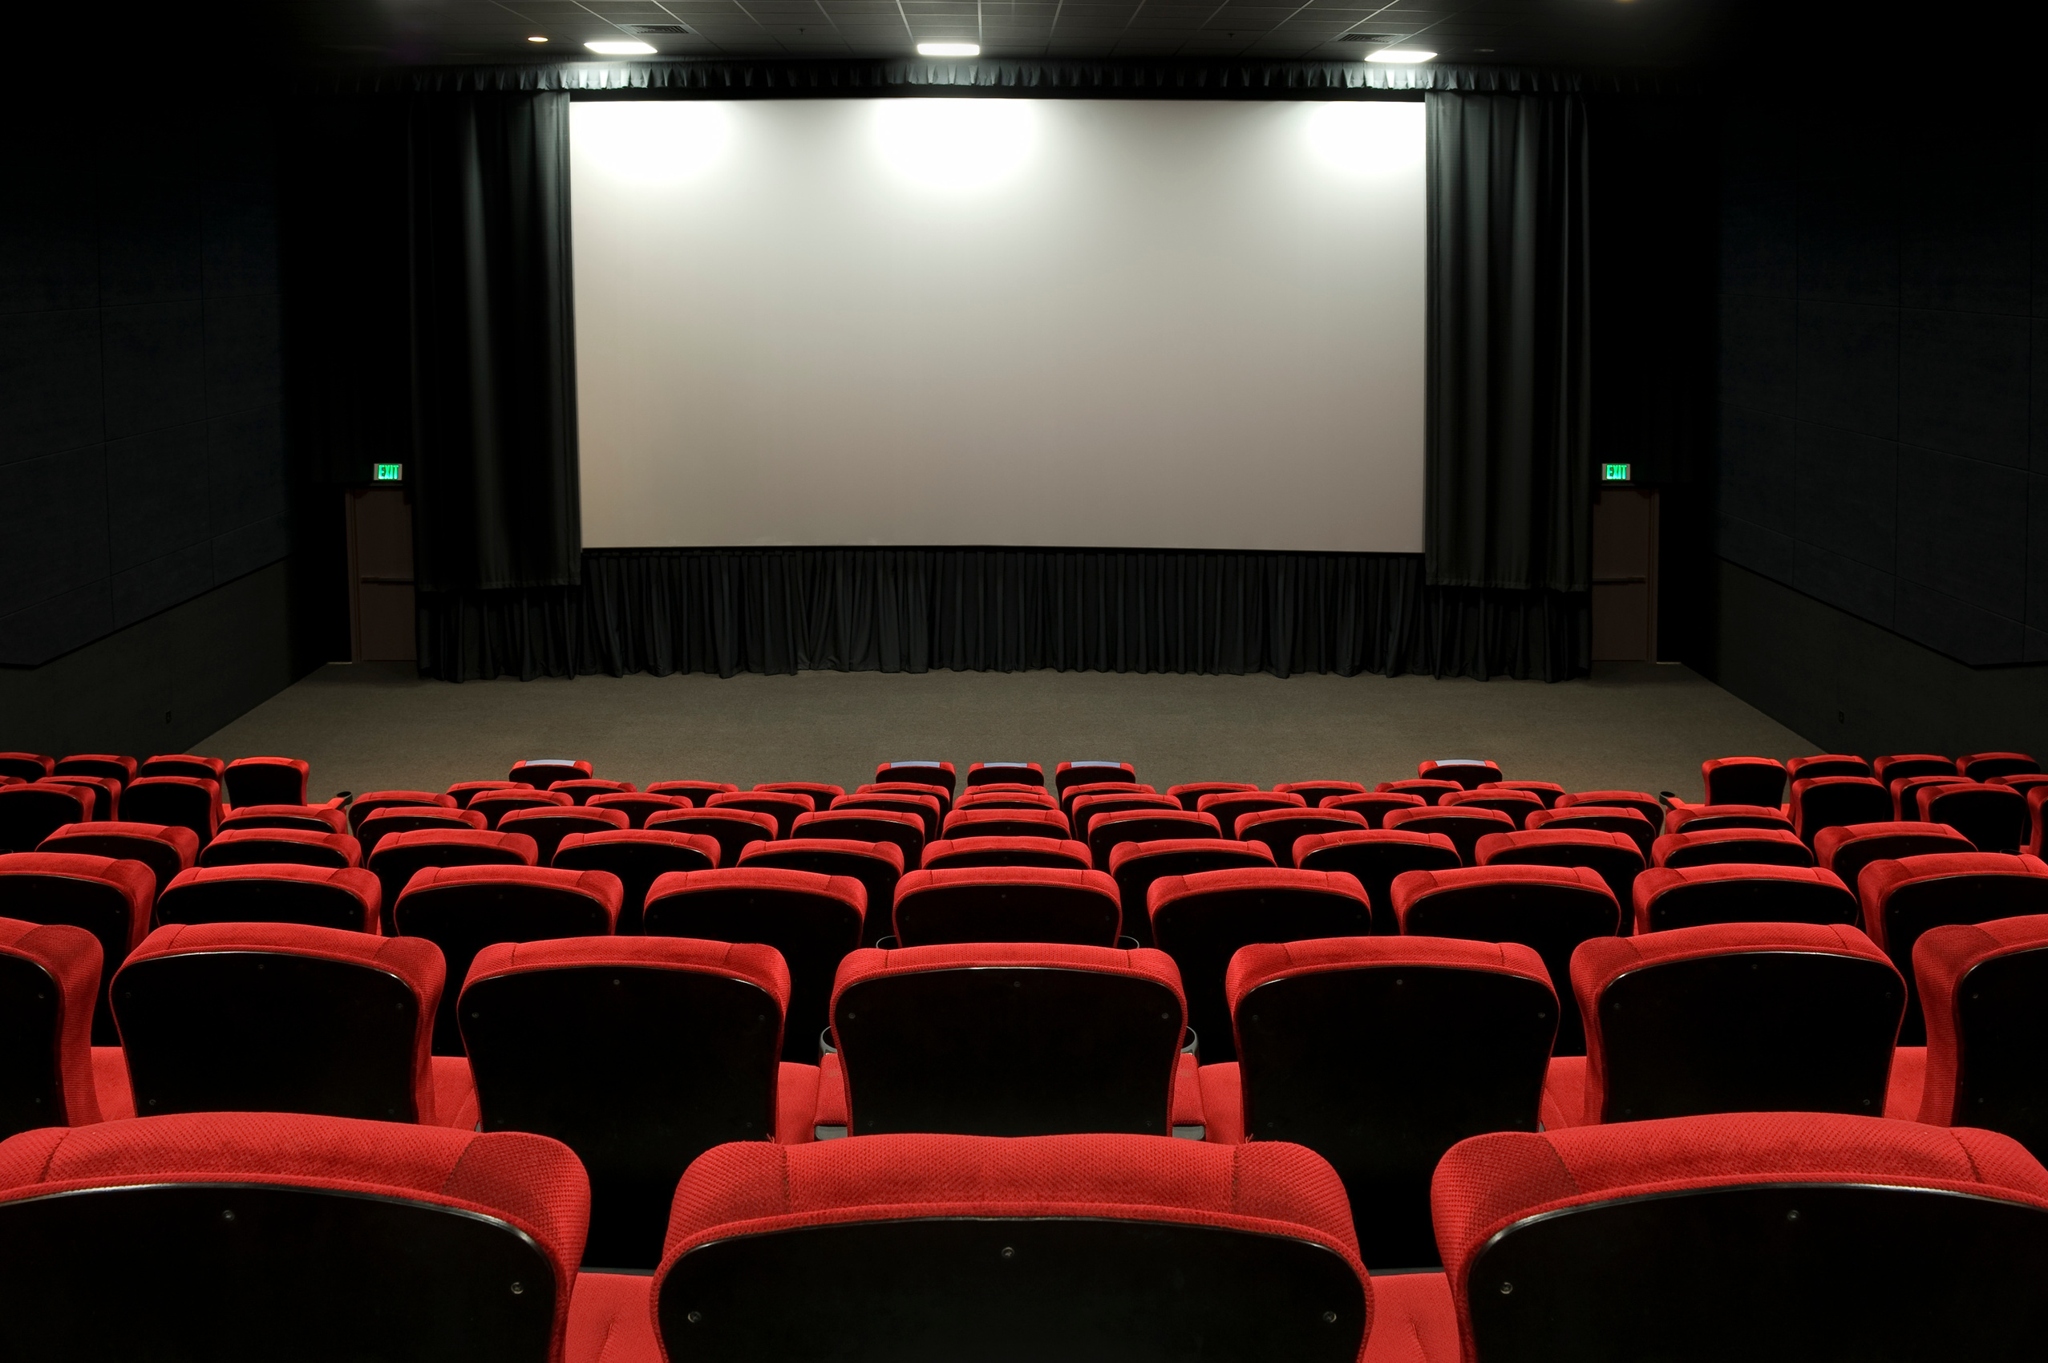

StarFlix: Your Ultimate Movie Destination
Explore, Discover, and Dive into the World of Cinema

Slide 3

Introduction
Welcome to "The StarFlix " project presentation.
The StarFlix Web App is a project that we developed using HTML, CSS, and JavaScript. The purpose of the project is to create a simple and user-friendly web-based Movie Database that allows users to see recomendation of there favourite, resent once and up-coming movies, web-series online.

Slide 4

Overview of the technologies used in the project
HTML for structuring the content of web pages.
CSS for styling and enhancing the visual presentation of the website.
JavaScript for adding interactivity and dynamic behavior to web pages.
Bootstrap: Simplify development with components for responsive, mobile-first design.

Slide 5

Features
User Authentication: Implement user accounts to allow users to sign up, log in.
Movie Listings: Display a comprehensive list of movies and series, including details such as title, and genre.
Movie Details: Provide detailed information about each movie and series.
Responsive Design for optimal viewing across various devices.

Slide 6
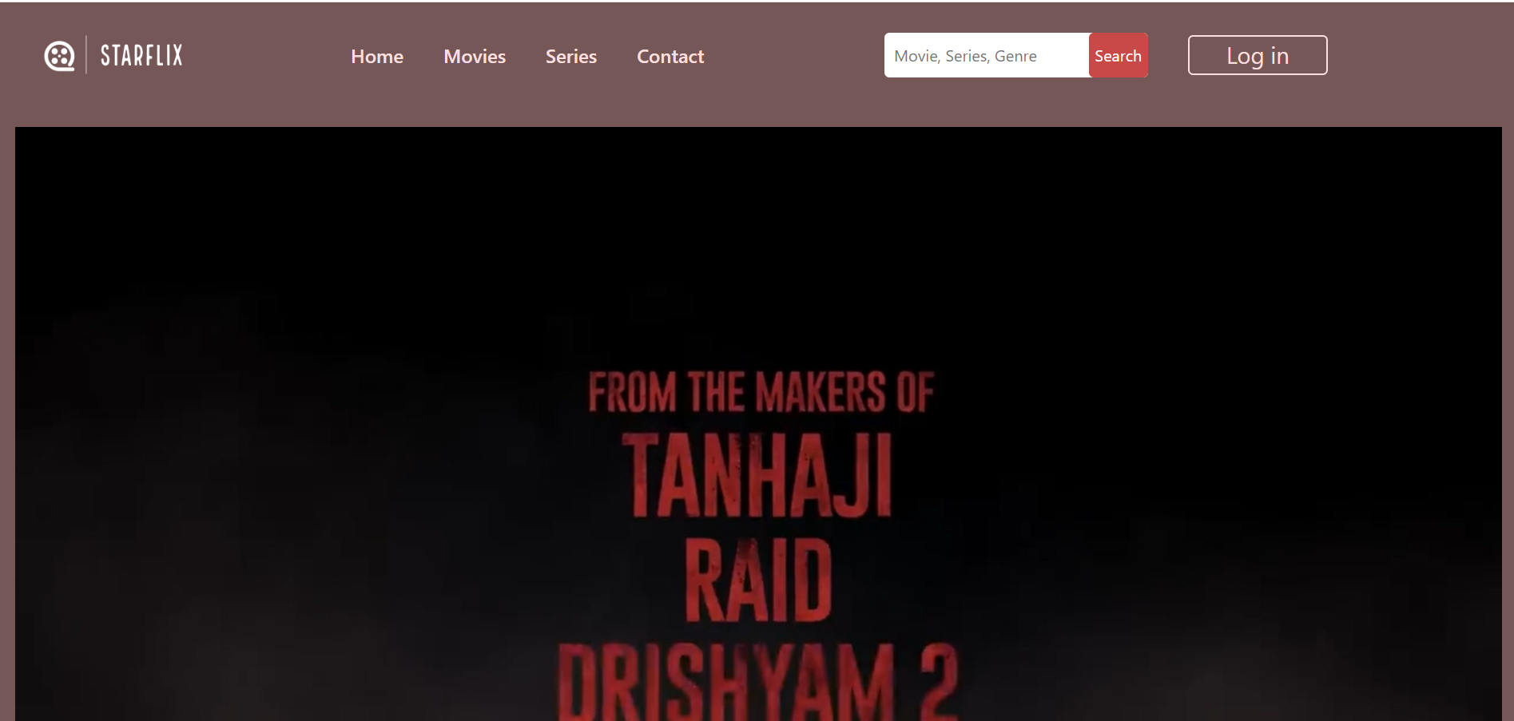
Overview of home page

Slide 7
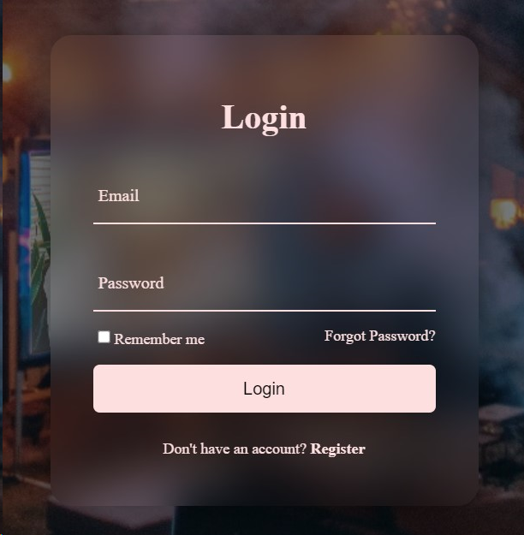
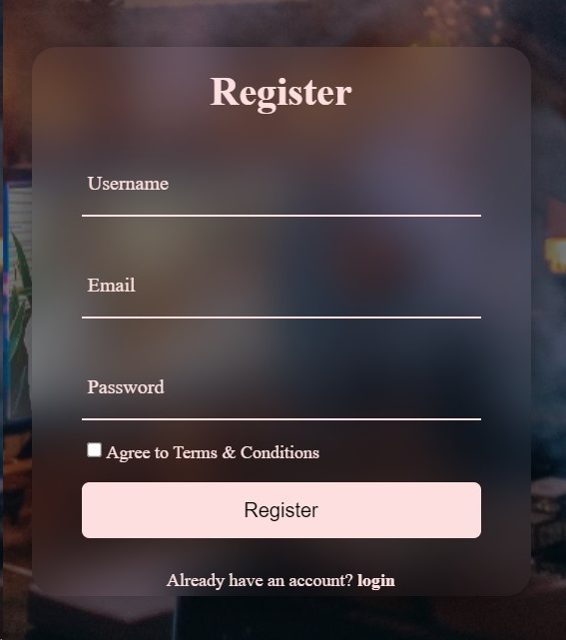
USER
AUTHENTICATION
There is login page in which when
we enter email and password it ask’s
for registered email id .
You have to go on Register page for creating
your account by entering your credentials
in it.
After Registering account you can login
into the Starflix

Slide 8
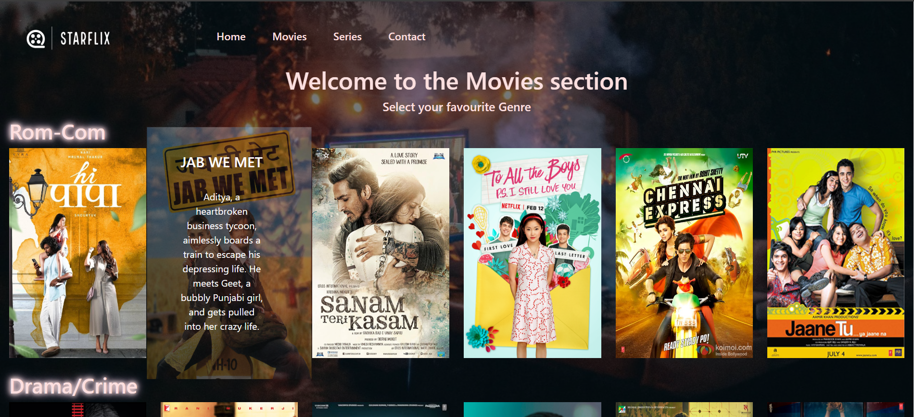
Overview of movies page

Slide 9
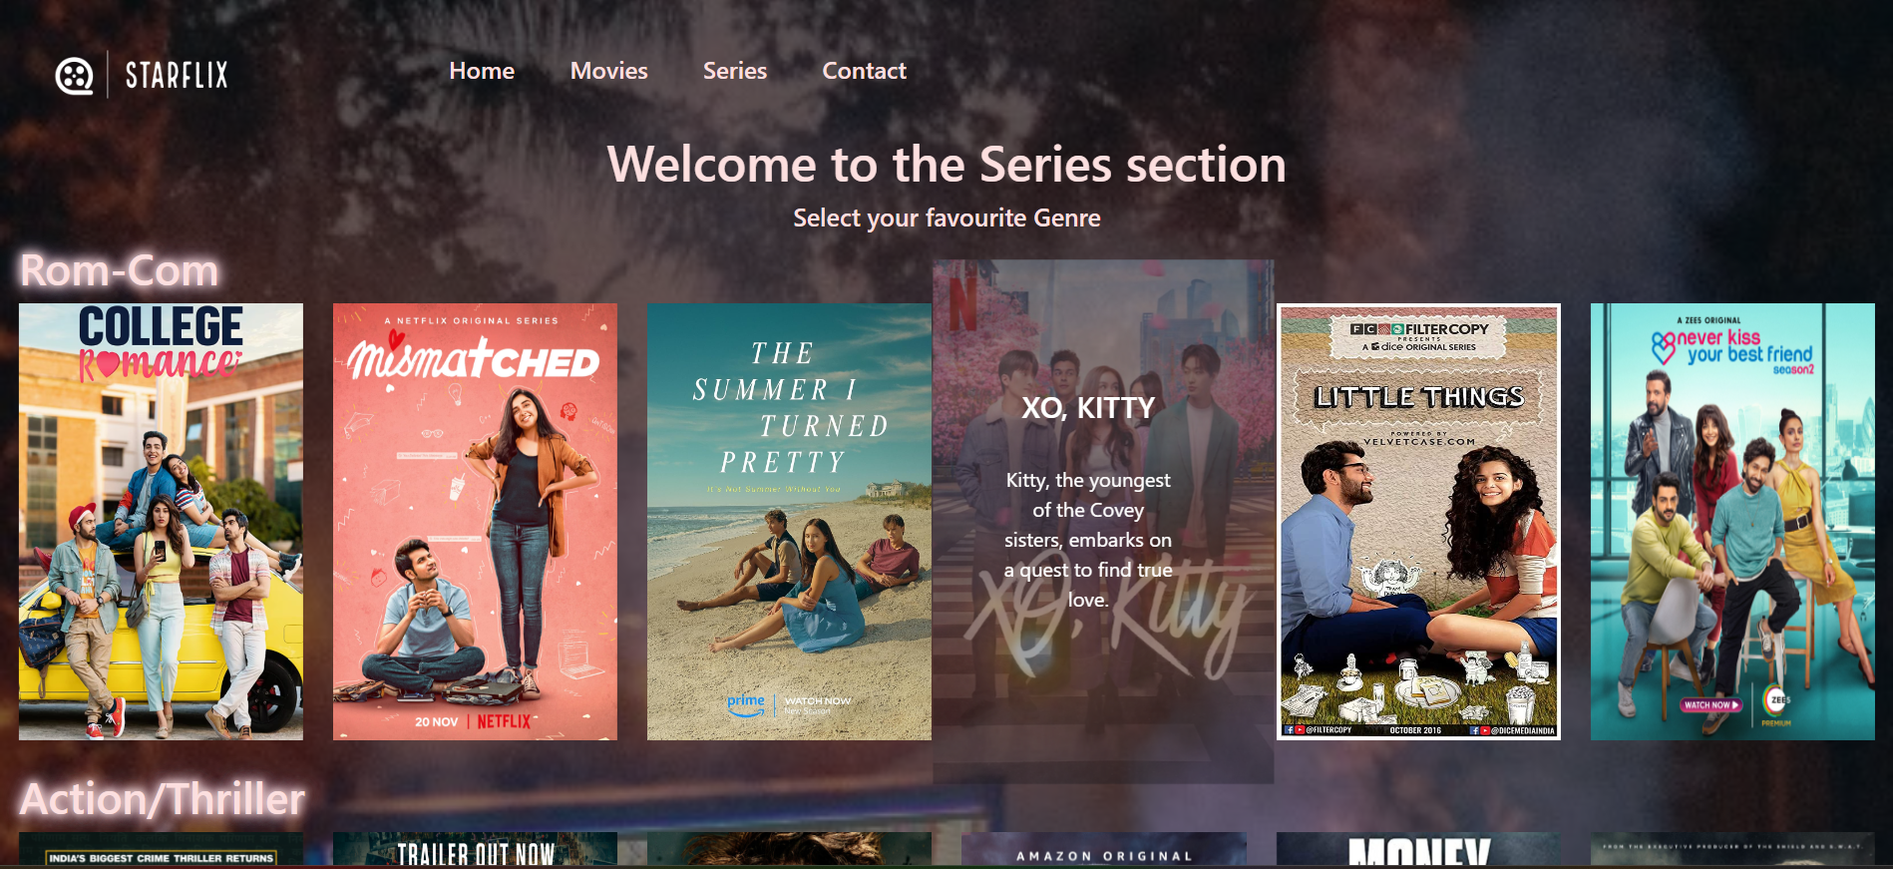
Overview of series page

Slide 10
Future Scope
1. Enhanced User Experience: Continuously improving the interface to make it more user-friendly and intuitive, possibly integrating voice commands or virtual reality for a more immersive experience.
2. Expanded Content: Adding more diverse content such as reviews, trailers, behind-the-scenes footage, and interviews with cast and crew.
3. Integration with External APIs: Incorporating data from external APIs such as movie reviews, box office performance, and awards data to enrich the database and provide more comprehensive information to users.

Slide 11

Conclusion
StarFlix: Your cinematic adventure starts here. With a vast library of films, personalized recommendations, and a vibrant community, there's something for everyone. Connect, explore, and immerse yourself in the magic of storytelling. Join us now and let the movie magic begin !

Slide 12
References
https://www.w3schools.com
https://getbootstrap.com
https://www.google.com
https://www.canva.com/

Slide 13


